Slide 1
Introduction to Job Submission with HTCondor
August 7, 2023
Rachel Lombardi
Slides adapted from Lauren Michaels
This work was supported by NSF grants MPS-1148698, OAC-1836650, and OAC-2030508

Slide 2
Overview
How does the HTCondor job scheduler work?
How do you run, monitor, and review jobs?
Best ways to submit multiple jobs
Testing, tuning, and troubleshooting to scale up

Slide 3
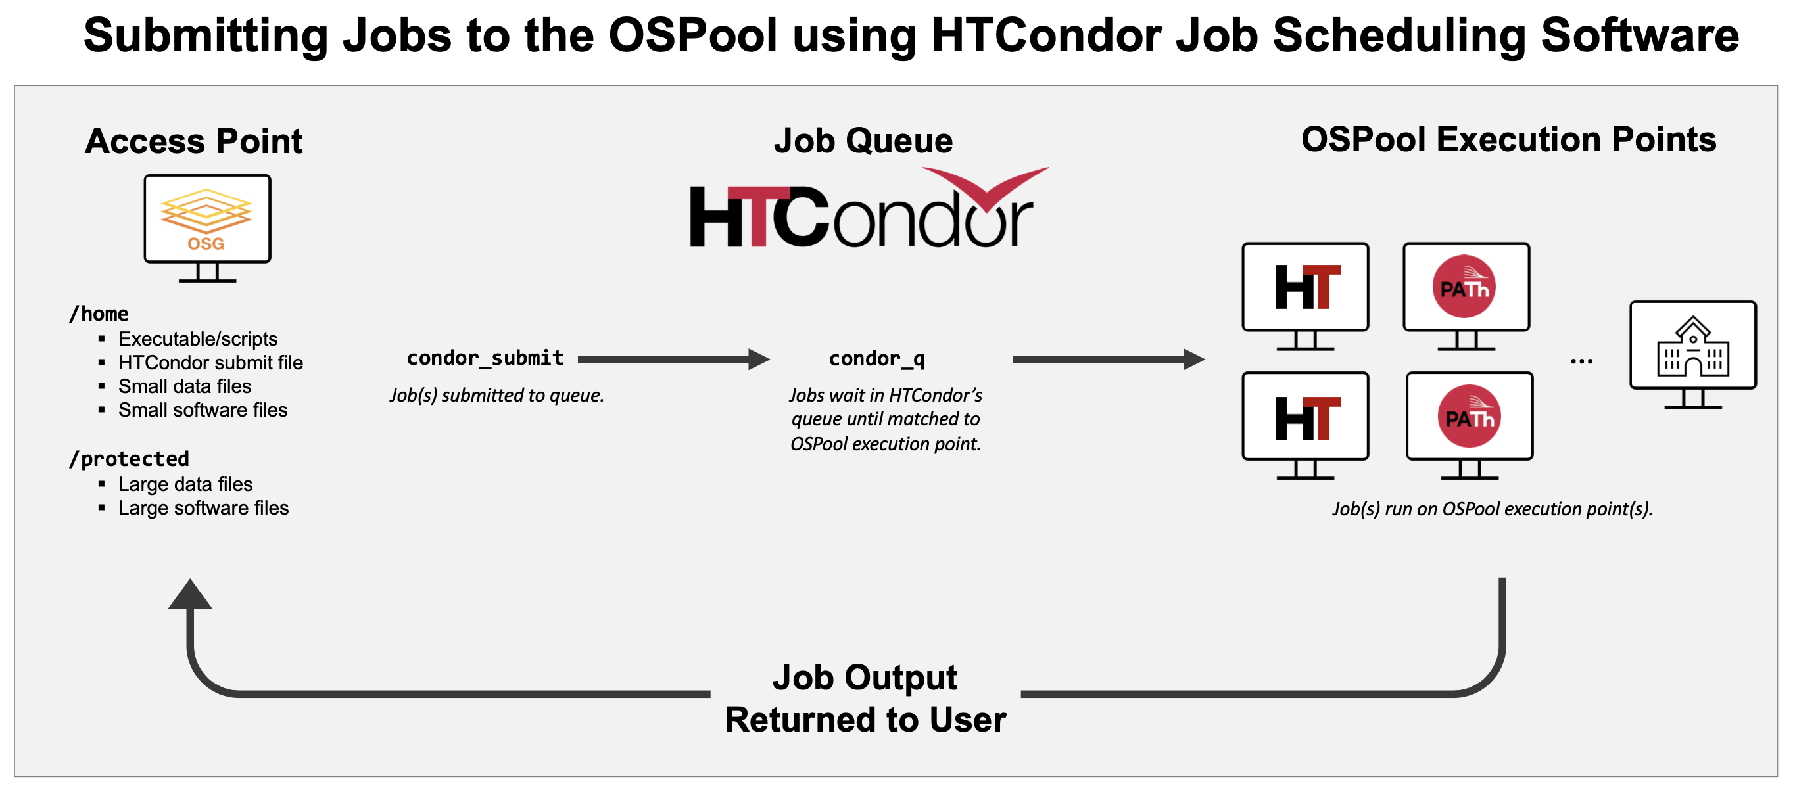
Takeaway
HTCondor is a Job Scheduling Software

Slide 4
History of HTCOndor

Slide 5


HTCondor History and Status
History
Started in 1988 as a “cycle scavenger”
Today
Developed within the CHTC by professional developers
Used all over the world, by:
campuses, national labs, Einstein/Folding@Home
Dreamworks, Boeing, SpaceX, investment firms, …
The OSG!!
Miron Livny
Professor, UW-Madison Computer Sciences
CHTC Director, OSG Technical Director

Slide 6
How does HTCondor work?

Slide 7



HTCondor -- How It Works
On an access point, you submit tasks to a queue
HTCondor schedules them to run on computers (execute points)
access point
execute point
execute point
execute point

Slide 8
Terminology: Job
Job: An independently-scheduled unit of computing work
Three main pieces:
Executable: the script or program to run
Input: any options (arguments) and/or file-based information
Output: files printed by the executable
Note: In order to run many jobs, executable must run on the command-line without any graphical input from the user

Slide 9
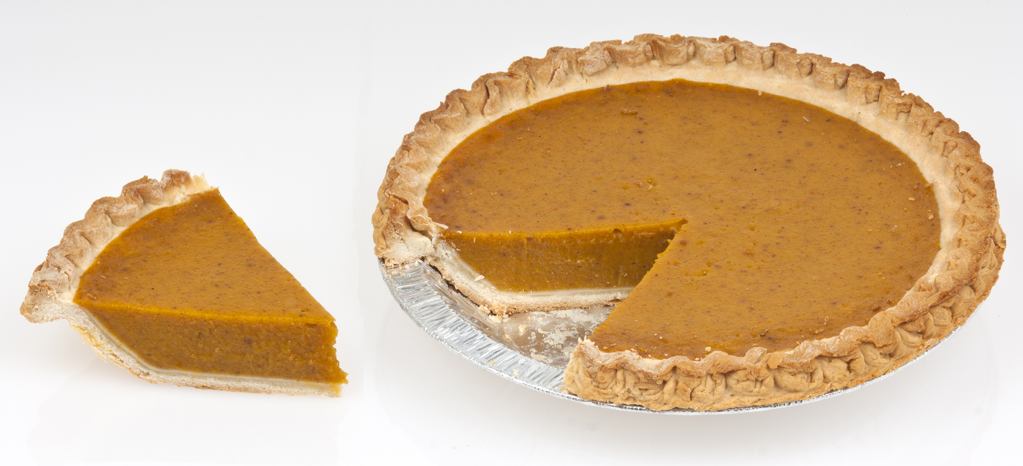
Terminology: Machine, Slot
Machine
A whole computer (desktop or server)
Has multiple processors (CPU cores), some amount of memory, and some amount of file space (disk)
Slot
an assignable unit of a machine (i.e. 1 job per slot)
may correspond to one core with some memory and disk
a typical machine will have multiple slots
HTCondor can break up and create new slots, dynamically, as resources become available from completed jobs

Slide 10

Job Matching
On a regular basis, the central manager reviews Job and Machine attributes and matches jobs to Slots.
execute point
access point
central manager
execute point
execute point
10

Slide 11
Job Execution
Then the access and execute points communicate directly.
execute point
access point
central manager
execute point
execute point
11

Slide 12
Basics of submitting jobs

Slide 13
Job Example
Example: program called “compare_states” (executable), which compares two data files (input) and produces a single output file.
wi.dat
compare_
states
wi.dat.out
us.dat
$ compare_states wi.dat us.dat wi.dat.out

Slide 14
Basic Submit File
executable = compare_states
arguments = wi.dat us.dat wi.dat.out
transfer_input_files = us.dat, wi.dat
log = job.log
output = job.out
error = job.err
request_cpus = 1
request_disk = 20MB
request_memory = 20MB
queue 1

Slide 15
Basic Submit File
executable = compare_states
arguments = wi.dat us.dat wi.dat.out
transfer_input_files = us.dat, wi.dat
log = job.log
output = job.out
error = job.err
request_cpus = 1
request_disk = 20MB
request_memory = 20MB
queue 1
List your executable and any arguments it takes
Arguments are any options passed to the executable from the command line
$ compare_states wi.dat us.dat wi.dat.out

Slide 16
Basic Submit File
executable = compare_states
arguments = wi.dat us.dat wi.dat.out
transfer_input_files = us.dat, wi.dat
log = job.log
output = job.out
error = job.err
request_cpus = 1
request_disk = 20MB
request_memory = 20MB
queue 1
Provide HTCondor a comma-separated list of input files to transfer to the slot
wi.dat
us.dat

Slide 17
Basic Submit File
executable = compare_states
arguments = wi.dat us.dat wi.dat.out
transfer_input_files = us.dat, wi.dat
log = job.log
output = job.out
error = job.err
request_cpus = 1
request_disk = 20MB
request_memory = 20MB
queue 1
HTCondor will transfer back all new and changed files (output) from the job, automatically.
wi.dat.out

Slide 18
Basic Submit File
executable = compare_states
arguments = wi.dat us.dat wi.dat.out
transfer_input_files = us.dat, wi.dat
log = job.log
output = job.out
error = job.err
request_cpus = 1
request_disk = 20MB
request_memory = 20MB
queue 1
log: file created by HTCondor to track job progress
Explored in exercises!
output/error: captures stdout and stderr from your program (what would otherwise be printed to the terminal)

Slide 19
Basic Submit File
executable = compare_states
arguments = wi.dat us.dat wi.dat.out
transfer_input_files = us.dat, wi.dat
log = job.log
output = job.out
error = job.err
request_cpus = 1
request_disk = 20MB
request_memory = 20MB
queue 1
request_cpus, request_disk, request_memory:
the resources your job needs.

Slide 20
Basic Submit File
executable = compare_states
arguments = wi.dat us.dat wi.dat.out
transfer_input_files = us.dat, wi.dat
log = job.log
output = job.out
error = job.err
request_cpus = 1
request_disk = 20MB
request_memory = 20MB
queue 1
Very important to request appropriate resources (memory, cpus, disk)
requesting too little: causes problems for your jobs; jobs might by ‘held’ by HTCondor
requesting too much: jobs will match to fewer “slots” than they could, and you’ll block other jobs

Slide 21
Basic Submit File
executable = compare_states
arguments = wi.dat us.dat wi.dat.out
transfer_input_files = us.dat, wi.dat
log = job.log
output = job.out
error = job.err
request_cpus = 1
request_disk = 20MB
request_memory = 20MB
queue 1
queue: keyword indicating the number of jobs to queue
- must be the last line of the submit file
- has different syntax options we will learn later!

Slide 22
Submitting and monitoring htcondor jobs

Slide 23
Submitting and Monitoring
To submit a job/jobs: condor_submit submit_file
To monitor submitted jobs: condor_q
$ condor_submit job.submit
Submitting job(s).
1 job(s) submitted to cluster 128.
$ condor_q
-- Schedd: learn.chtc.wisc.edu : <128.104.101.92> @ 05/01/22 10:35:54
OWNER BATCH_NAME SUBMITTED DONE RUN IDLE TOTAL JOB_IDS
alice CMD: compare_states 5/9 11:05 _ _ 1 1 128.0
1 jobs; 0 completed, 0 removed, 1 idle, 0 running, 0 held, 0 suspended
HTCondor Manual: condor_submit
HTCondor Manual: condor_q

Slide 24
More about condor_q
By default, condor_q shows your jobs only and batches jobs that were submitted together:
Limit condor_q by username, ClusterId or full JobId, (denoted [U/C/J] in following slides).
$ condor_q
-- Schedd: learn.chtc.wisc.edu : <128.104.101.92> @ 05/01/22 10:35:54
OWNER BATCH_NAME SUBMITTED DONE RUN IDLE TOTAL JOB_IDS
alice CMD: compare_states 5/9 11:05 _ _ 1 1 128.0
1 jobs; 0 completed, 0 removed, 1 idle, 0 running, 0 held, 0 suspended
JobId = ClusterID.ProcID

Slide 25
More about condor_q
To see individual job details, use:
condor_q –nobatch
We will use the -nobatch option in the following slides to see extra detail about what is happening with a job
$ condor_q -nobatch
-- Schedd: learn.chtc.wisc.edu : <128.104.101.92>
ID OWNER SUBMITTED RUN_TIME ST PRI SIZE CMD
128.0 alice 5/9 11:09 0+00:00:00 I 0 0.0 compare_states
128.1 alice 5/9 11:09 0+00:00:00 I 0 0.0 compare_states
...
1 jobs; 0 completed, 0 removed, 1 idle, 0 running, 0 held, 0 suspended

Slide 26
Observing Job STATES with condor_q

Slide 27
Job Idle
$ condor_q -nobatch
-- Schedd: submit-5.chtc.wisc.edu : <128.104.101.92>
ID OWNER SUBMITTED RUN_TIME ST PRI SIZE CMD
128.0 alice 5/9 11:09 0+00:00:00 I 0 0.0 compare_states wi.dat us.dat
1 jobs; 0 completed, 0 removed, 1 idle, 0 running, 0 held, 0 suspended
Access Point
(submit_dir)/
job.submit
compare_states
wi.dat
us.dat
job.log
job.out
job.err

Slide 28
Job Starts
$ condor_q -nobatch
-- Schedd: submit-5.chtc.wisc.edu : <128.104.101.92:9618>
ID OWNER SUBMITTED RUN_TIME ST PRI SIZE CMD
128.0 alice 5/9 11:09 0+00:00:00 < 0 0.0 compare_states wi.dat us.dat
1 jobs; 0 completed, 0 removed, 0 idle, 1 running, 0 held, 0 suspended
Access Point
Execute Point
(execute_dir)/
(submit_dir)/
job.submit
compare_states
wi.dat
us.dat
job.log
job.out
job.err
(execute_dir)/
compare_states
wi.dat
us.dat

Slide 29
Job Running
$ condor_q -nobatch
-- Schedd: submit-5.chtc.wisc.edu : <128.104.101.92>
ID OWNER SUBMITTED RUN_TIME ST PRI SIZE CMD
128.0 alice 5/9 11:09 0+00:01:08 R 0 0.0 compare_states wi.dat us.dat
1 jobs; 0 completed, 0 removed, 0 idle, 1 running, 0 held, 0 suspended
Access Point
Execute Point
(submit_dir)/
job.submit
compare_states
wi.dat
us.dat
job.log
job.out
job.err
(execute_dir)/
compare_states
wi.dat
us.dat
stderr
stdout
wi.dat.out
subdir/tmp.dat

Slide 30
Job Completes
$ condor_q -nobatch
-- Schedd: submit-5.chtc.wisc.edu : <128.104.101.92>
ID OWNER SUBMITTED RUN_TIME ST PRI SIZE CMD
128 alice 5/9 11:09 0+00:02:02 > 0 0.0 compare_states wi.dat us.dat
1 jobs; 0 completed, 0 removed, 0 idle, 1 running, 0 held, 0 suspended
Access Point
Execute Point
(submit_dir)/
job.submit
compare_states
wi.dat
us.dat
job.log
job.out
job.err
(execute_dir)/
compare_states
wi.dat
us.dat
stderr
stdout
wi.dat.out
subdir/tmp.dat
stderr
stdout
wi.dat.out

Slide 31
Job Completes (cont.)
$ condor_q -nobatch
-- Schedd: submit-5.chtc.wisc.edu : <128.104.101.92:9618?...
ID OWNER SUBMITTED RUN_TIME ST PRI SIZE CMD
0 jobs; 0 completed, 0 removed, 0 idle, 0 running, 0 held, 0 suspended
Access Point
(submit_dir)/
job.submit
compare_states
wi.dat
us.dat
job.log
job.out
job.err
wi.dat.out

Slide 32
Reviewing Completed Jobs

Slide 33
Log File
000 (128.000.000) 05/09 11:09:08 Job submitted from host: <128.104.101.92&sock=6423_b881_3>
...
001 (128.000.000) 05/09 11:10:46 Job executing on host: <128.104.101.128:9618&sock=5053_3126_3>
...
006 (128.000.000) 05/09 11:10:54 Image size of job updated: 220
1 - MemoryUsage of job (MB)
220 - ResidentSetSize of job (KB)
...
005 (128.000.000) 05/09 11:12:48 Job terminated.
(1) Normal termination (return value 0)
Usr 0 00:00:00, Sys 0 00:00:00 - Run Remote Usage
Usr 0 00:00:00, Sys 0 00:00:00 - Run Local Usage
Usr 0 00:00:00, Sys 0 00:00:00 - Total Remote Usage
Usr 0 00:00:00, Sys 0 00:00:00 - Total Local Usage
0 - Run Bytes Sent By Job
33 - Run Bytes Received By Job
0 - Total Bytes Sent By Job
33 - Total Bytes Received By Job
Partitionable Resources : Usage Request Allocated
Cpus : 1 1
Disk (KB) : 14 20480 17203728
Memory (MB) : 1 20 20

Slide 34
Reviewing Jobs
To review a large group of jobs at once, use condor_history
As condor_q is to the present, condor_history is to the past
$ condor_history alice
ID OWNER SUBMITTED RUN_TIME ST COMPLETED CMD
189.1012 alice 5/11 09:52 0+00:07:37 C 5/11 16:00 /home/alice
189.1002 alice 5/11 09:52 0+00:08:03 C 5/11 16:00 /home/alice
189.1081 alice 5/11 09:52 0+00:03:16 C 5/11 16:00 /home/alice
189.944 alice 5/11 09:52 0+00:11:15 C 5/11 16:00 /home/alice
189.659 alice 5/11 09:52 0+00:26:56 C 5/11 16:00 /home/alice
189.653 alice 5/11 09:52 0+00:27:07 C 5/11 16:00 /home/alice
189.1040 alice 5/11 09:52 0+00:05:15 C 5/11 15:59 /home/alice
189.1003 alice 5/11 09:52 0+00:07:38 C 5/11 15:59 /home/alice
189.962 alice 5/11 09:52 0+00:09:36 C 5/11 15:59 /home/alice
189.961 alice 5/11 09:52 0+00:09:43 C 5/11 15:59 /home/alice
189.898 alice 5/11 09:52 0+00:13:47 C 5/11 15:59 /home/alice
HTCondor Manual: condor_history

Slide 35
Questions?

